Slide 1
Analytics - Test

Slide 2
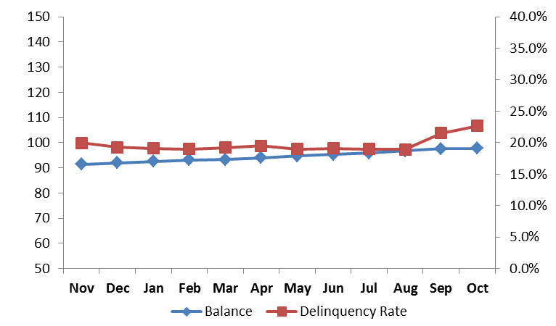
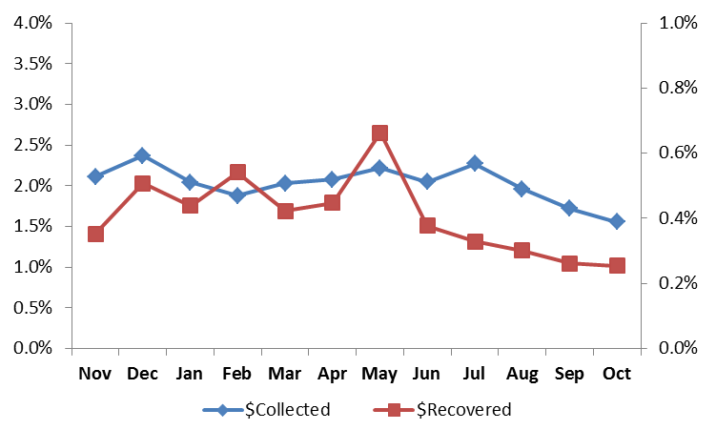
Situation
The Operations & Corporate Services Vice President has received the following chart about balances in delinquency (non current) which clearly shows an increase in the last two months. At the same time, the recoveries trends have shown a steep decline
Using this template, he has requested you to put together 1-2 slide(s) of analysis to summarize the situation and 1 slide to make a recommendation to remediate the situation
Delinquency Trend
Recoveries Trends
$ Collected – Front end
$ Recovered- Back End

Slide 3
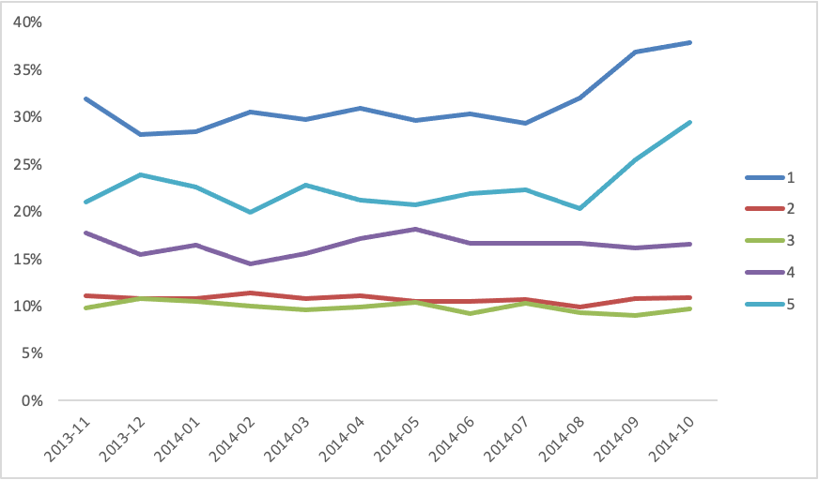
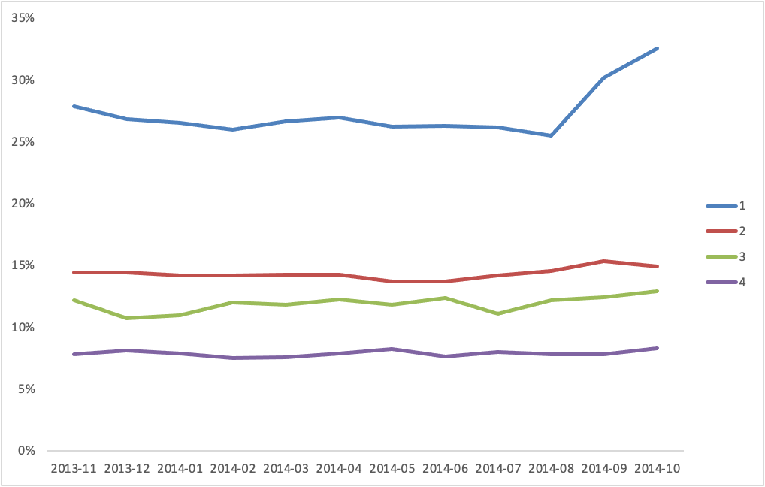
Summary
Sites
Products
Sites 1,4 and 5 seem to be the major issues
Products 1 and 2 should be looked at. 3 can also be considered as an issue

Slide 4
Recommendations
Current data cannot infers where the decline is occurring but not the cause. Potential next steps
Deep dive into the Products and Sites that are having the decline
Find whether it is a client or business problem

Slide 5
Instructions
Complete the following exercise in Excel.
Calculate the cure rate by site. Paste into table below:
2) Calculate the percentage of dollars recovered by product name. Paste into table below:
Create a pivot table
In your pivot table insert a calculated fields for:
Delinquency Rate
Dollars Collected & Rate
Dollars Recovered & Rate
Identify which sites and which products are driving the increase in delinquency rates.
Present findings/analysis in 1-2 slides and 1 slide of recommendations to remediate the situation (total 2-3 slides)
Finally, you will present your final work to Saheeb Sayedi for review at 3:00pm on August 19th 2022.
Site | Cure Rate
1 | 0.8
2 | 0.3
3 | 0.2
4 | 0.4
5 | 0.5
Product Name | Recovered Rate
Credit Cards (1) | 0.11
Line of Credit (2) | 0.13
Loans (3) | 0.13
Mortgage (4) | 0.04
No Product names exist in the Excel file. Assumption is Product names outlined are in line with Product Numbers.

